Slide 1
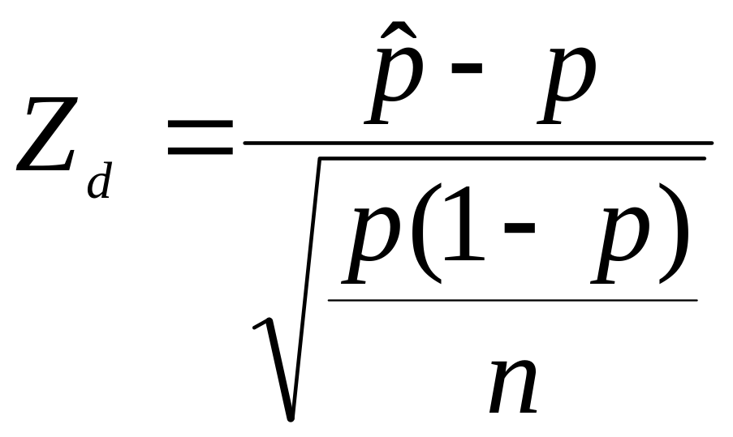
Hypothesis Testing for Proportions
Where p is the proportion as stated in the null hypothesis Ho.

Slide 2
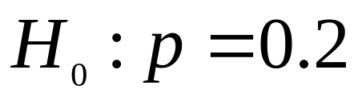
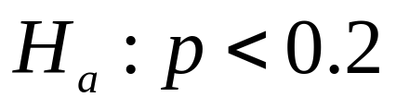
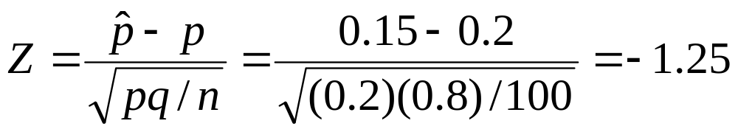
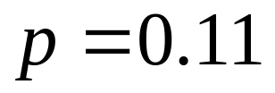
Example
A medical researcher states that less than 20% of adults in the US are allergic to a medication. In a random sample of 100 adults, 15% say they have such an allergy. Test the researcher’s statement at α = 0.01.
POINT #1: It would seem logical that the claim is correct given that our sample of 15% confirms the researchers claim. However, given the null hypothesis, we can not reject that the true proportion p is over 20%.
POINT #2: We failed to reject the null hypothesis. If p actually is under 20%, then a Type II error has occurred.

Slide 3
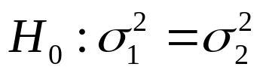

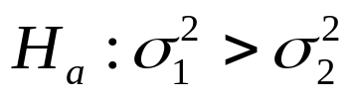
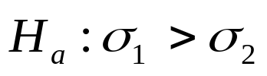
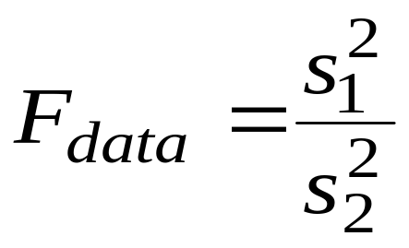
ANOVA for Comparing VARIANCES
The F distribution is used to test whether two samples are from populations having similar variances/standard deviations.
There is a “family” of F Distributions. Each member of the family is determined by two parameters: the numerator degrees of freedom and the denominator degrees of freedom.

Slide 4
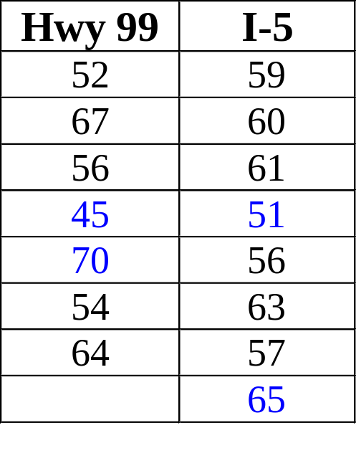
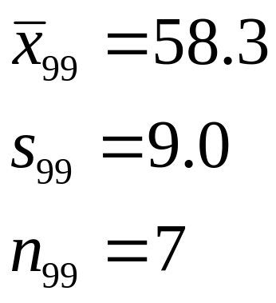
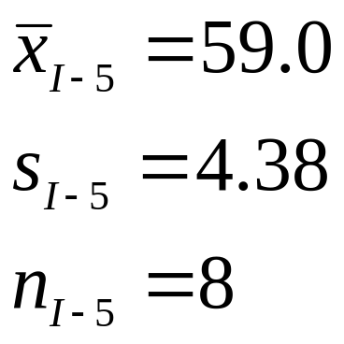



F Test Example
A manager of a taxi service wants to examine the time it takes to drive to Seatac airport from South-Western Tacoma using two different routes, one using highway 99 and the other using I-5. Since tight scheduling is a necessary part of the business, it’s important that the variation in the time of each route is kept to a minimum. From past experience it seems that the Hwy 99 route has much more variation and the manager wants to prove this to his company’s executives.
The following sample data of minutes per trip on each route was collected:
It appears that the taxi will be late much less frequently using this route.

Slide 5
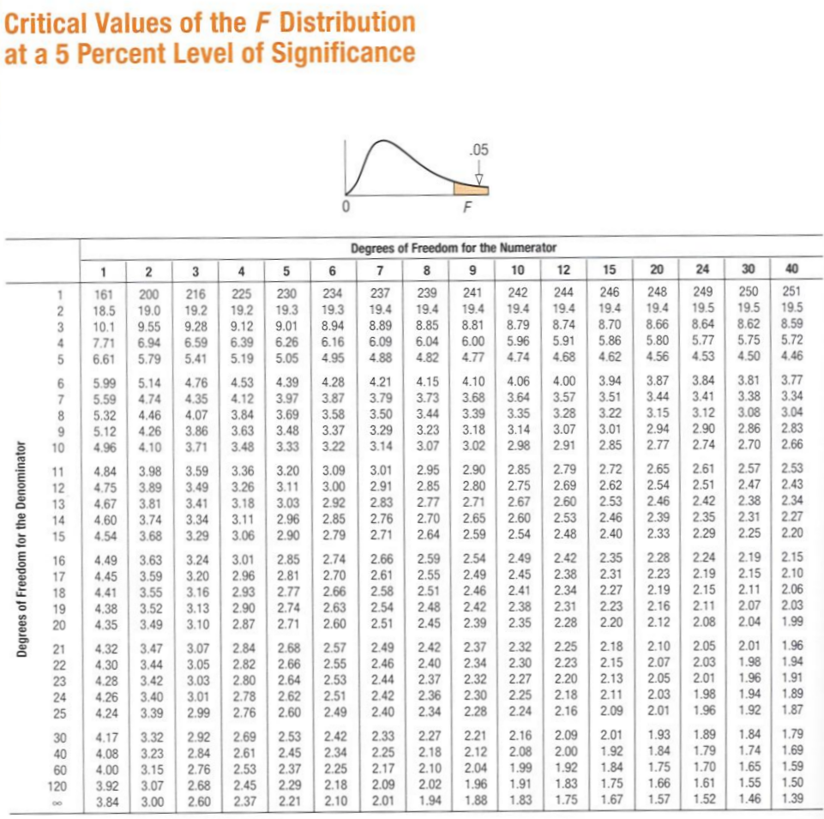
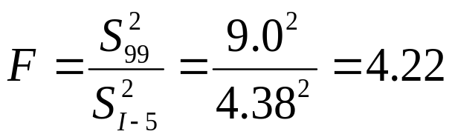

See Appendix P. T13-T16

Slide 6
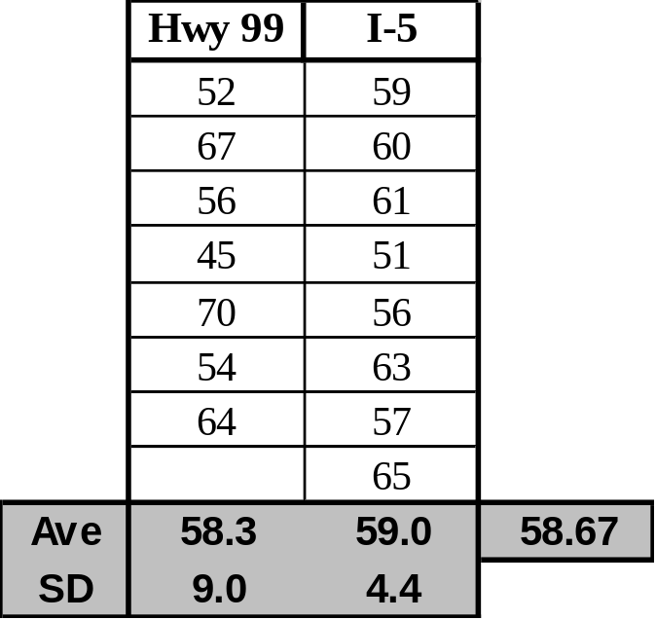


Therefore, our travel time will fluctuate significantly more when using Hwy 99.
See Appendix P. A26

